Slide 1
Myocardial Edema Imaging: Form TIRM to Myocardial T2-Mapping
Ali Nahardani

Slide 2
Introduction
Conventional Approaches
Pulse sequences
Pros & Cons
Quantification Methods
Clinical Examples
T2-Mapping
Pulse Sequences
Tips & Tricks
Quantification Methods
Clinical Examples

Slide 3
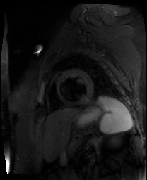
Triple Inversion Recovery

Slide 4
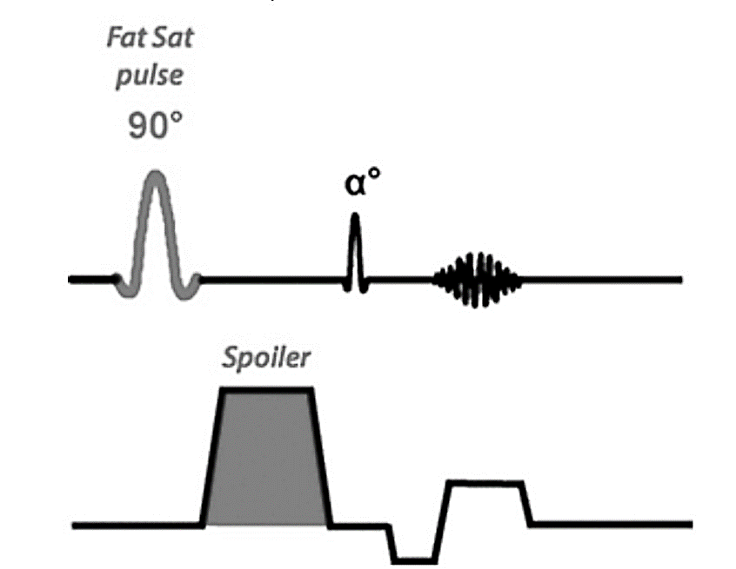
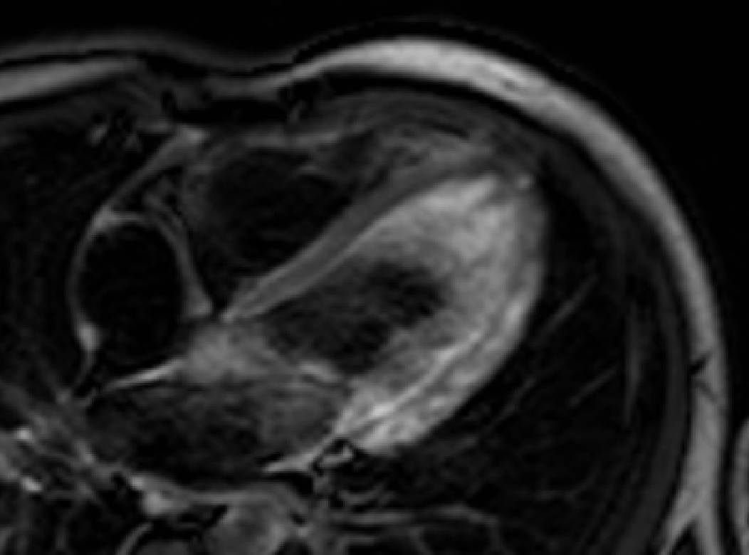
Is There Any Alternative Approach?
Chemical Shift Selective + TSE

Slide 5
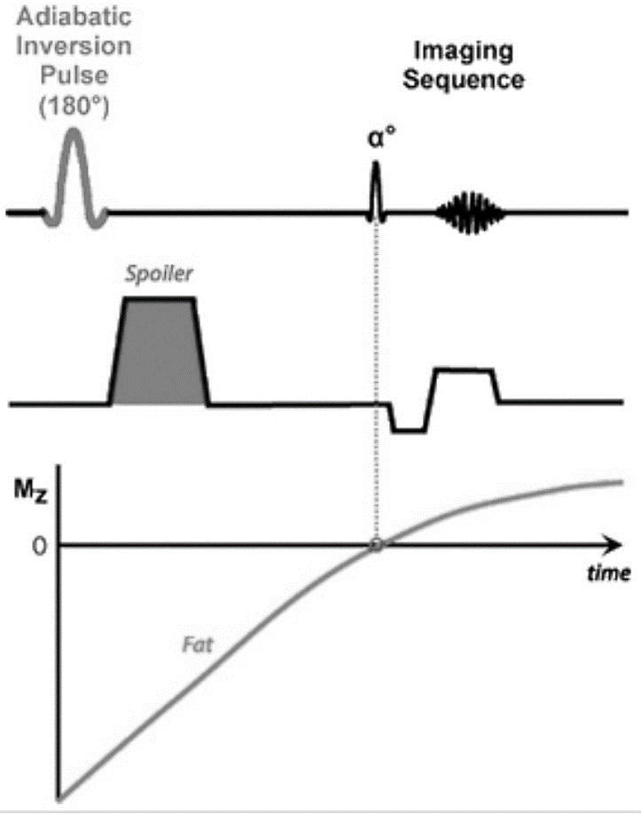
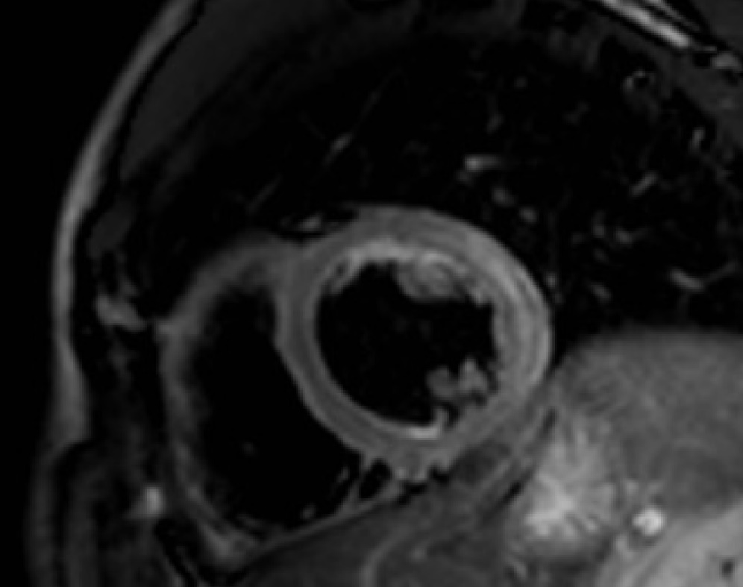
Is There Any Alternative Approach?
Adiabatic Spectral Attenuated Inversion Recovery + TSE

Slide 6
Pros & Cons

Slide 7
Pros & Cons

Slide 8
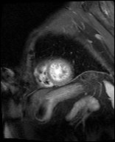
Pros & Cons

Slide 9
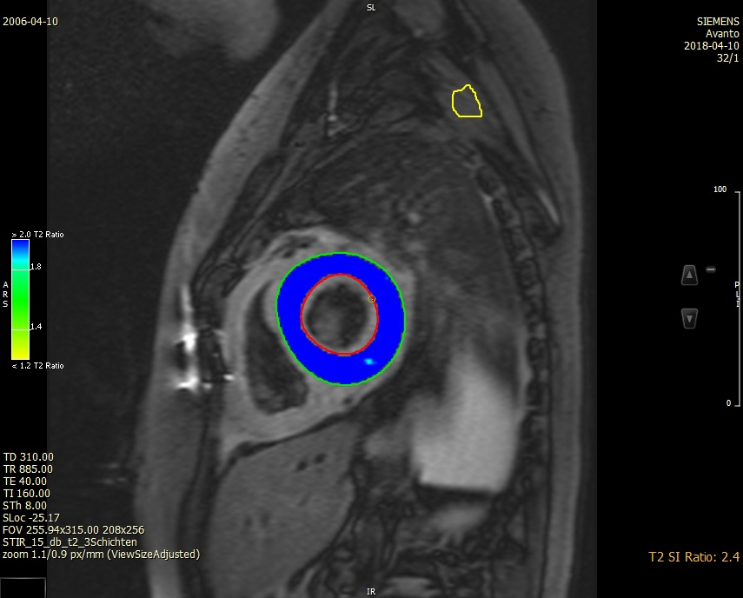
Pros & Cons

Slide 10
T2-Mapping
GRE-based T2 Mapping:
T2_3pt_3recovHB_gre (~11 second breath hold)
T2_3pt_3recovHB_trufi (~11 second breath hold)
TSE-based T2 Mapping

Slide 11
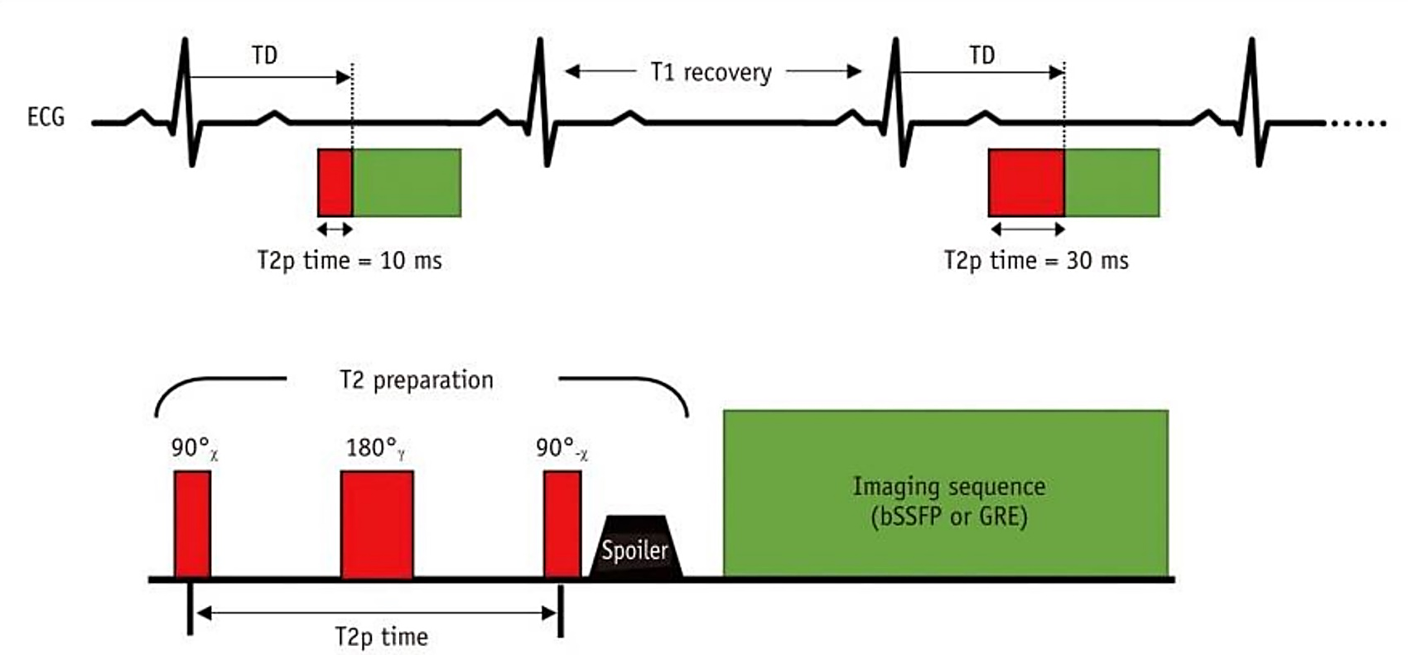
GRE-based T2-Mapping
T2_3pt_3recovHB_gre (~11 second breath hold)
T2_3pt_3recovHB_trufi (~11 second breath hold)

Slide 12
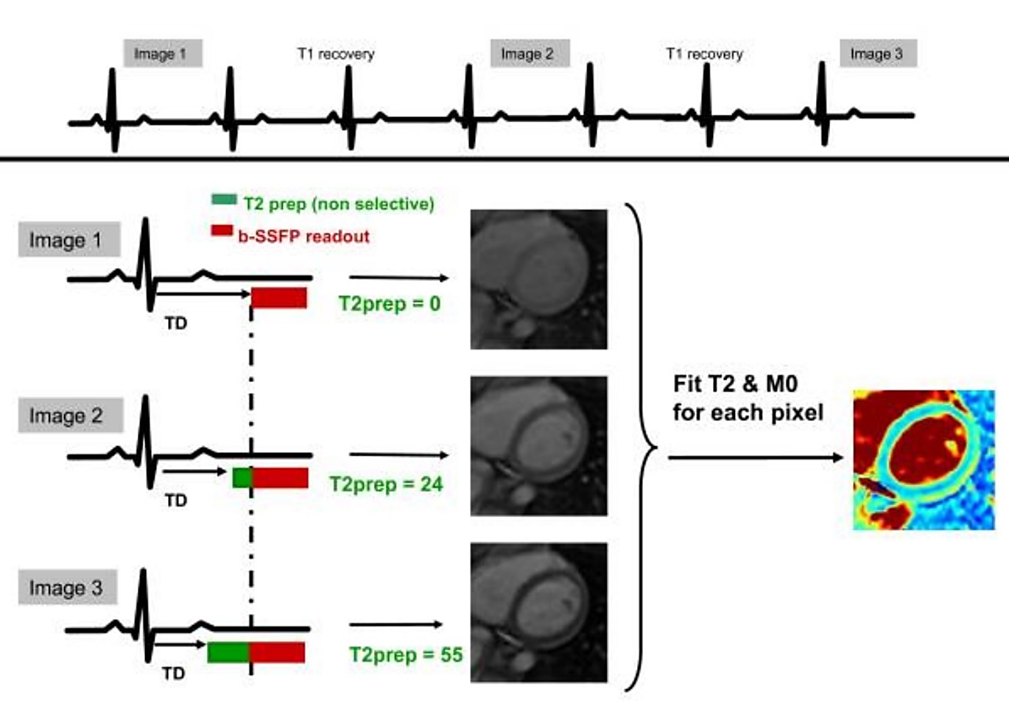
GRE-based T2-Mapping
T2-prep TFI:
he TE_{T2P} times:
0 ms
24 ms
55 ms
$$SI\left(x,y\right)=M_{0}\left(x,y\right)e^{\frac{{−TE}_{T2P}}{{T2}_{(x,y)}}}$$

Slide 13
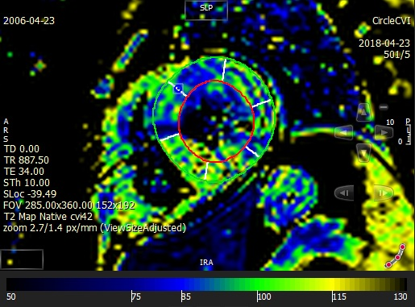
TSE-based T2-Mapping

Slide 14
GRE-based T2-Mapping Seq. Tab

Slide 15
GRE-based T2-Mapping Parameters
Parameter map type:
This selection controls the type of parameter map (T1/T2/T2*)
No. Of T2 preps:
Represents the number of T2-prepared images used for T2 fitting. The minimum value is 3 and the maximum value is 12.
T2 prep duration (array)
Represents the T2 prep duration. The array ranges from 1 to the number selected in “No. of T2 Preps”
Motion correction:
If selected, motion correction will be performed before curve-fitting and map generation.
Recovery HB:
This parameter controls the number of heartbeats that are used for recovery of the magnetization before the next T2p and readout. During the recovery heartbeats, the sequence plays gradient noises so that the subject doesn’t assume that the scan has finished and inadvertently start breathing.
Systolic imaging:
This checkbox should be enabled if imaging is performed during systole. It prevents possible SAR warnings in the case of a short trigger delay by including the time during diastole in the SAR calculations.

Slide 16
GRE-based T2-Mapping Tips & Tricks
The scan window must be positioned during diastole.
For DCM patients, gate through systole.
the maximum T2p value be in the vicinity of the expected T2 of the tissue being imaged. ***
If patient is cooperative, select more of the No. Of T2 preps.
For RR interval > 1000, select Recovery HB to 2-3.
*** Bottomley PA, Foster TH, Argersinger RE, Pfeifer LM: A review of normal tissue hydrogen NMR relaxation times and relaxation mechanisms from 1-100 MHz: dependence on tissue type, NMR frequency, temperature, species, excision, and age. Med Phys 1984, 11:425-448.

Slide 17
GRE-based T2-Mapping Tips & Tricks
T2-prep tfi overestimates T2 values (for its Linear Sequential Trajectory).
T2-prep tfi has higher SNR compared with T2-prep tfl.
T2-prep tfl has a linear centric trajectory.
The reason for keeping a linear readout for TrueFisp is to avoid artifacts due to off resonance. The error in T2 estimate using a linear TrueFisp is due to T1 effects between the T2p and the center of the readout. T2 mapping is not recommended post contrast, but its worth noting that if the linear TrueFisp version is run post contrast, the shorter T1 may result in large errors

Slide 18
Comparison of GRE-based T2-Mapping Sequences
Fl
Tfi
T2prep TE = 25 ms
T2prep TE = 0 ms
T2prep TE = 25 ms
T2prep TE = 55 ms
T2-Maps

Slide 20
Thank You So Much

